Slide 1

EGGS-ELLENT TRACKING
AUMelettes: Dr. Pape, Kayla Luther, Adam Rodriguez, Rebecca Hogue, Riley Taylor, David Whyte

Slide 2
Problem Statement:
The average American spends 2.5 days each year looking for lost items collectively costing U.S. $2.7B annually in replacement costs¹.
Create an inventory tracking mechanism using IoT applications.
Notes:
*We began our engineering process at step 1: Concept exploration. Lets identify the problem
* read slides
*Now that we are clear of what the problem is, let's identify the needs.

Slide 3
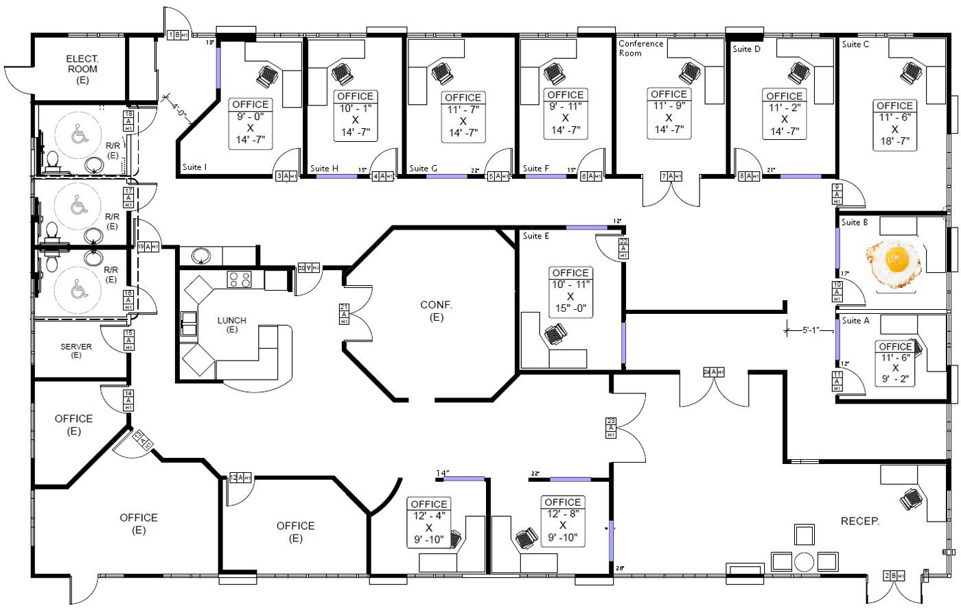
Notes:
An item is lost in this building we want a way to pull this map up and Identify the missing itemLike this

Slide 4
Requirements: M.E.T.A.
Near time logging of location of the asset,
five-minute location resolution.
Should be accurate to within 20 feet
U.I. designed to allow the user to find an asset on a GPS map quickly.
Device should be able to run for at least 24 hours
Device and asset must be paired using unique asset identification codes
Device should be physically connected to the asset.
size: 8cm x 12cm x 5cm
mass 0.6Kg (1.5lb)
Notes:
*Requirements! All requirements must be Measurable, Easy to understand, Testable, and most importantly Achievable!
* read all bullet points

Slide 5
Brainstorming
Challenges
Solution factors
Communications: NFC/RFID, Wireless internet, GPS
What data needs to be collected
How integrate security for sensitive/classified items
Egg puns
Time effective
cost effective
construction simplicity
Notes:
*Brainstorming: What do you call a smart omelette? An Egg Head!
*We brainstormed h

Slide 6
The E.G.G.
Electromagnetic Geolocating Gadget
Hardware:
System made of 4 components
Raspberry Pi 4 model B
NFC antena
speaker
Power Source
3 communication channels
NFC/ Radio Frequency
EntryPoints- NFC~ Fixed to physical locations like doorways
Mobile devices-NFC~ Variable locations, but accurate GPS location
Wifi Routers- Wifi~Fixed to physical locations
Notes:
This is the solution we agreed would best suit the user and meet requirements

Slide 7
The Basket
User Interface/Database
Software:
User Login
credential verification
Data Access
varies based on user credentials
intuitive

Slide 8
Databases
Items
Item ID
Last Update Time
Last Update Manner
Last User
Location (Map)
Battery Power Level
Over Easy
Poached
Eggs Benedict
Hard Boiled
Users
UsersID
Username
group
email
password
adam
Riley
Egghead
Presentation
HardBoiled
regular
egg@mail.com
Rt@egg.com
0v3rE@sy!
qwerty123

Slide 9
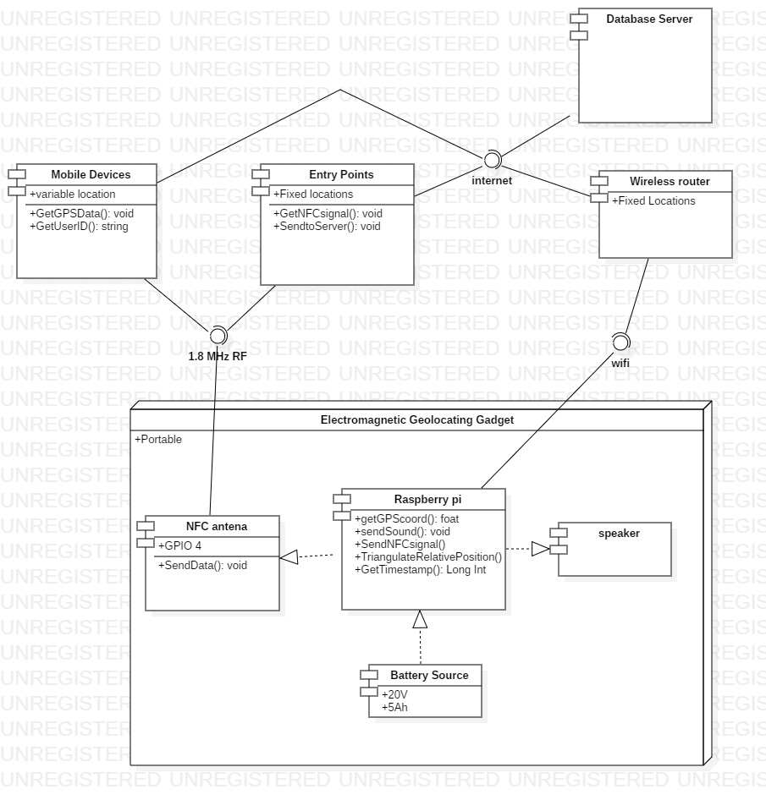
Product Communication Diagram

Slide 10
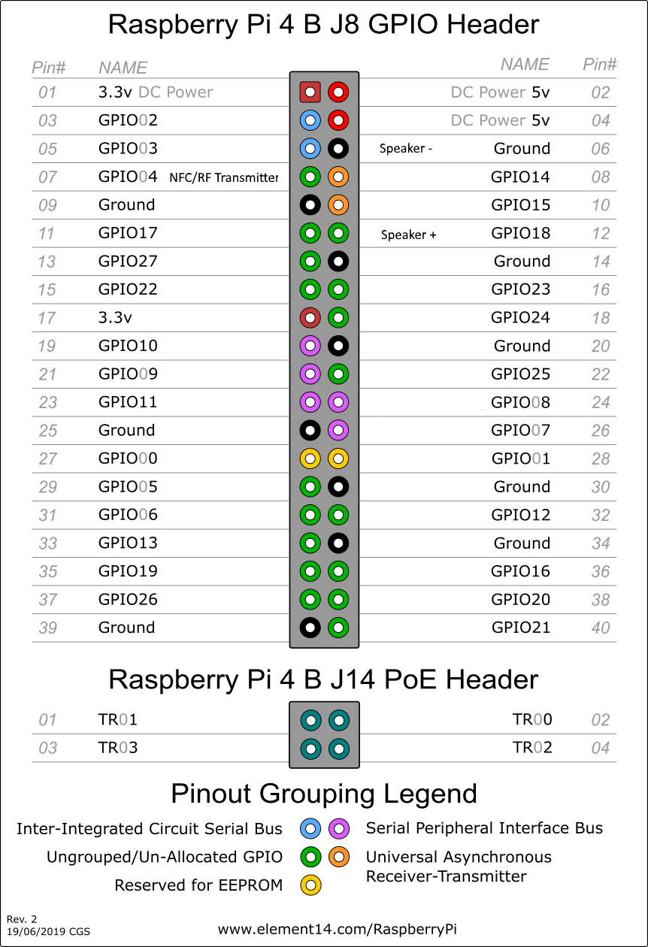
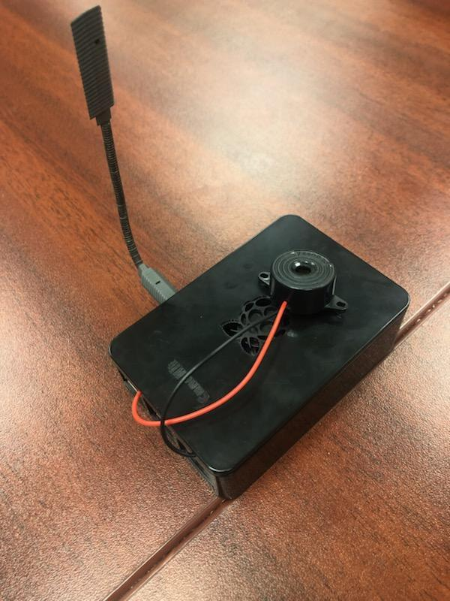
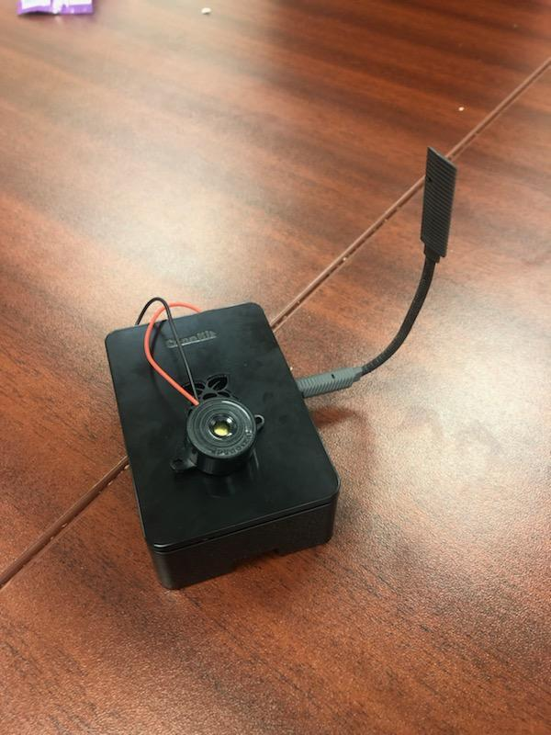
The E.G.G.
Electromagnetic Geolocating Gadget
Hardware:

Slide 11
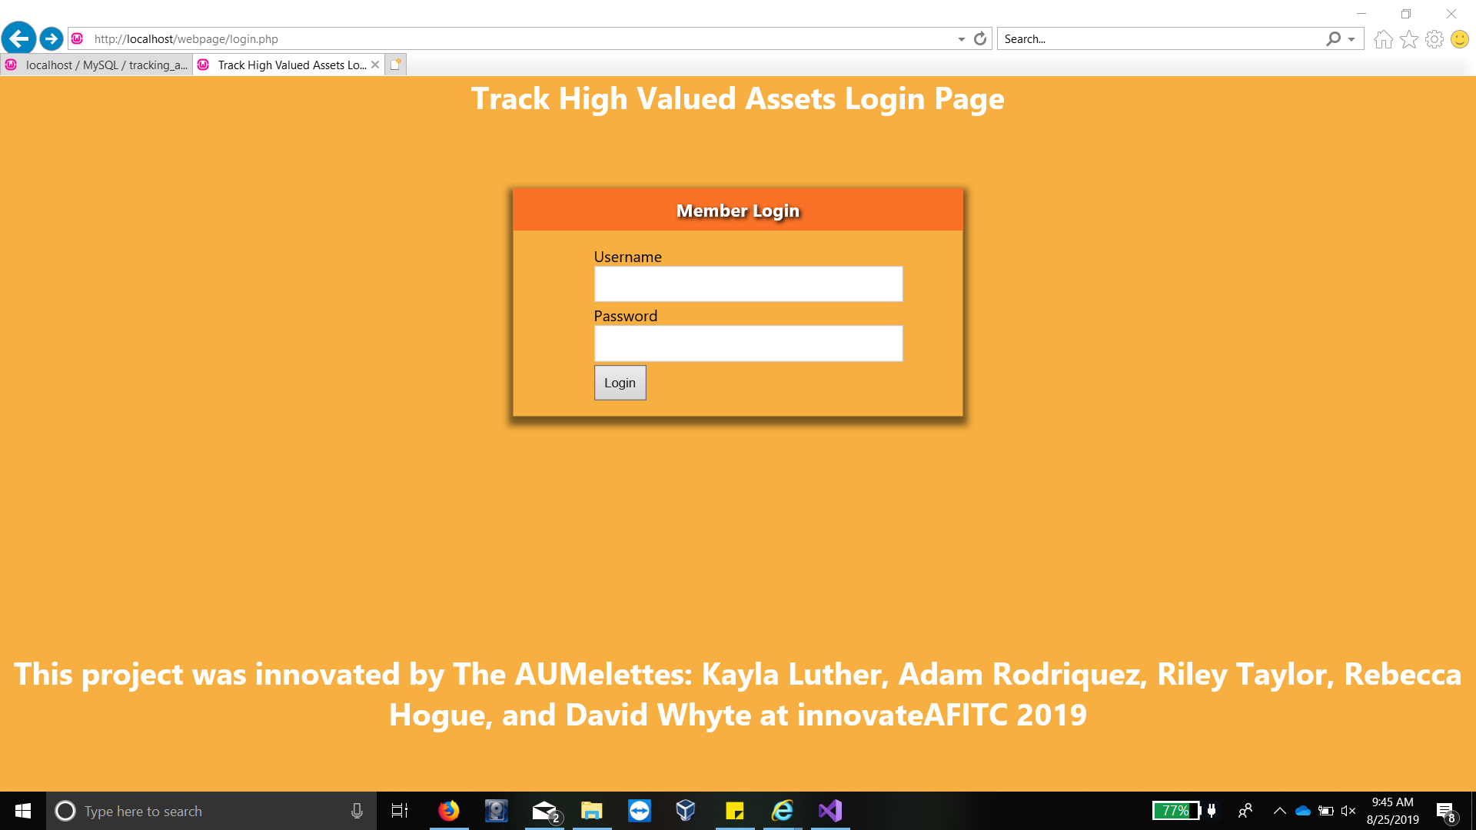
The Basket
User Interface/Database
Software:

Slide 12
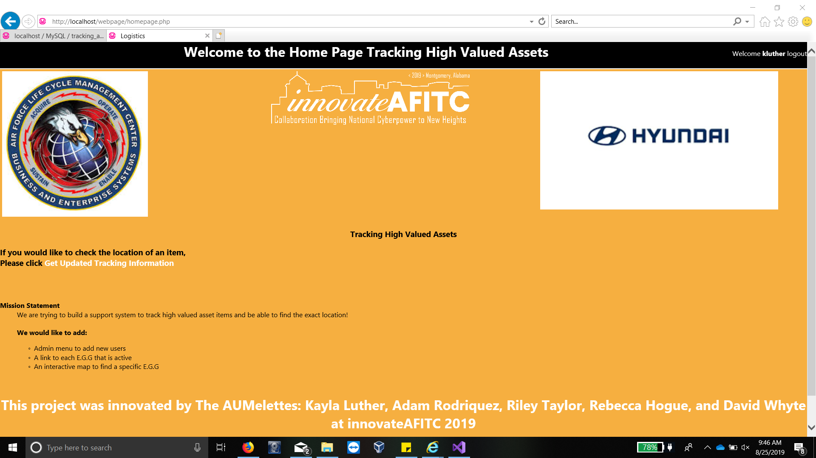

Slide 13
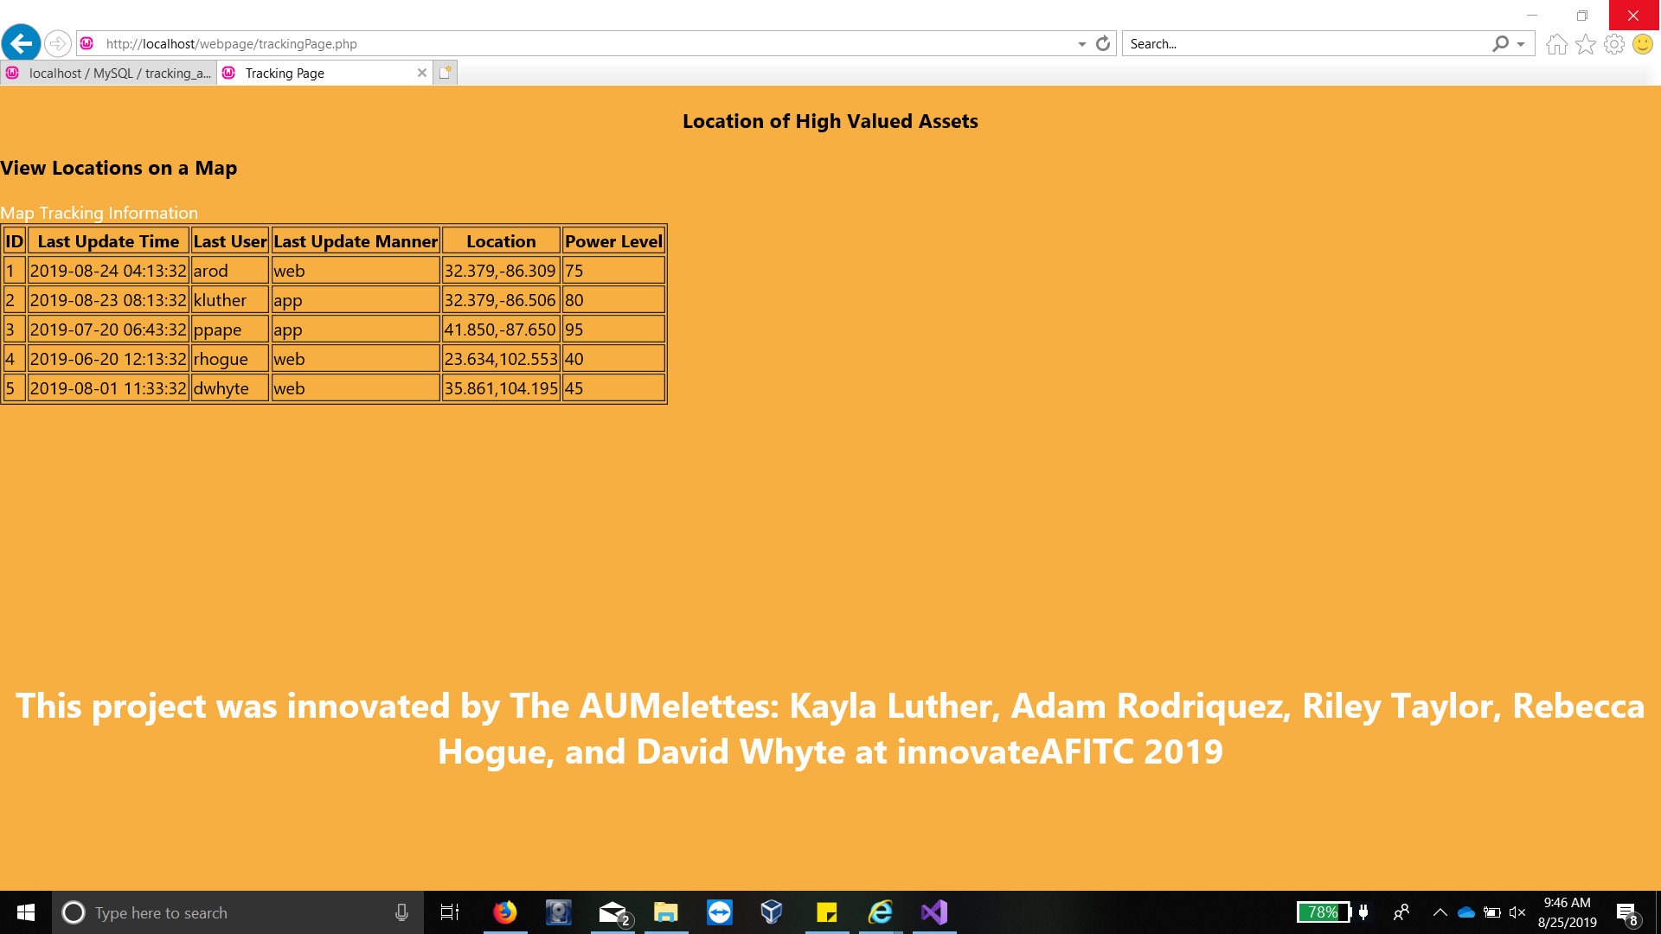

Slide 14
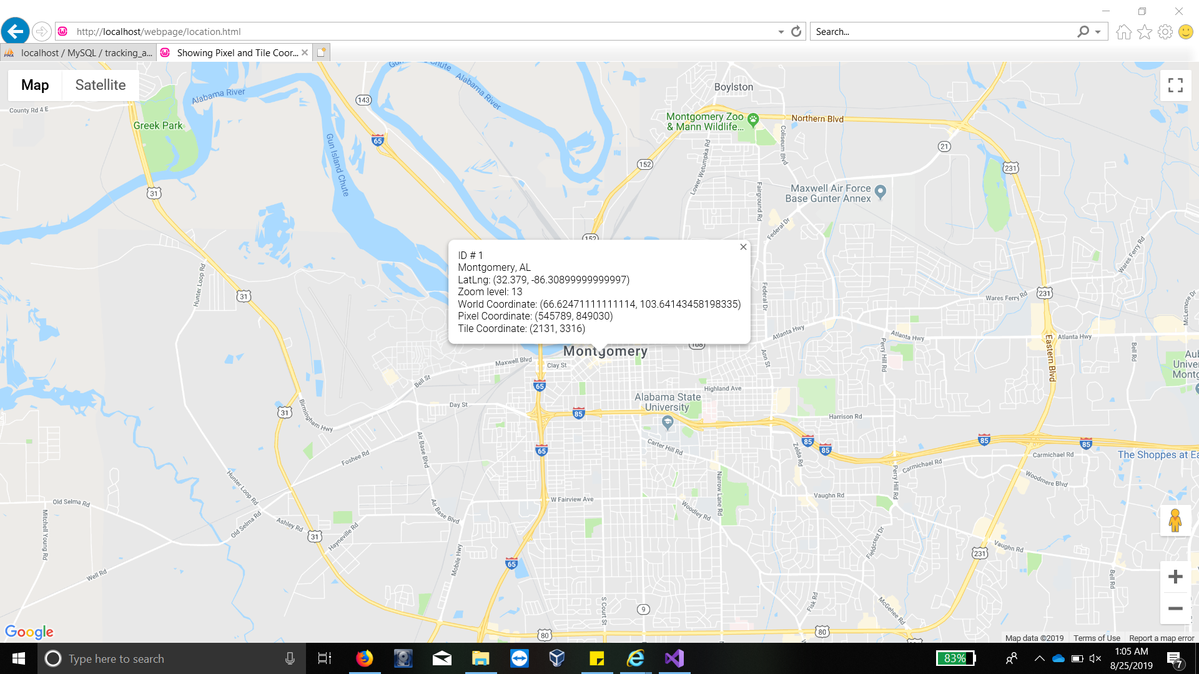

Slide 15
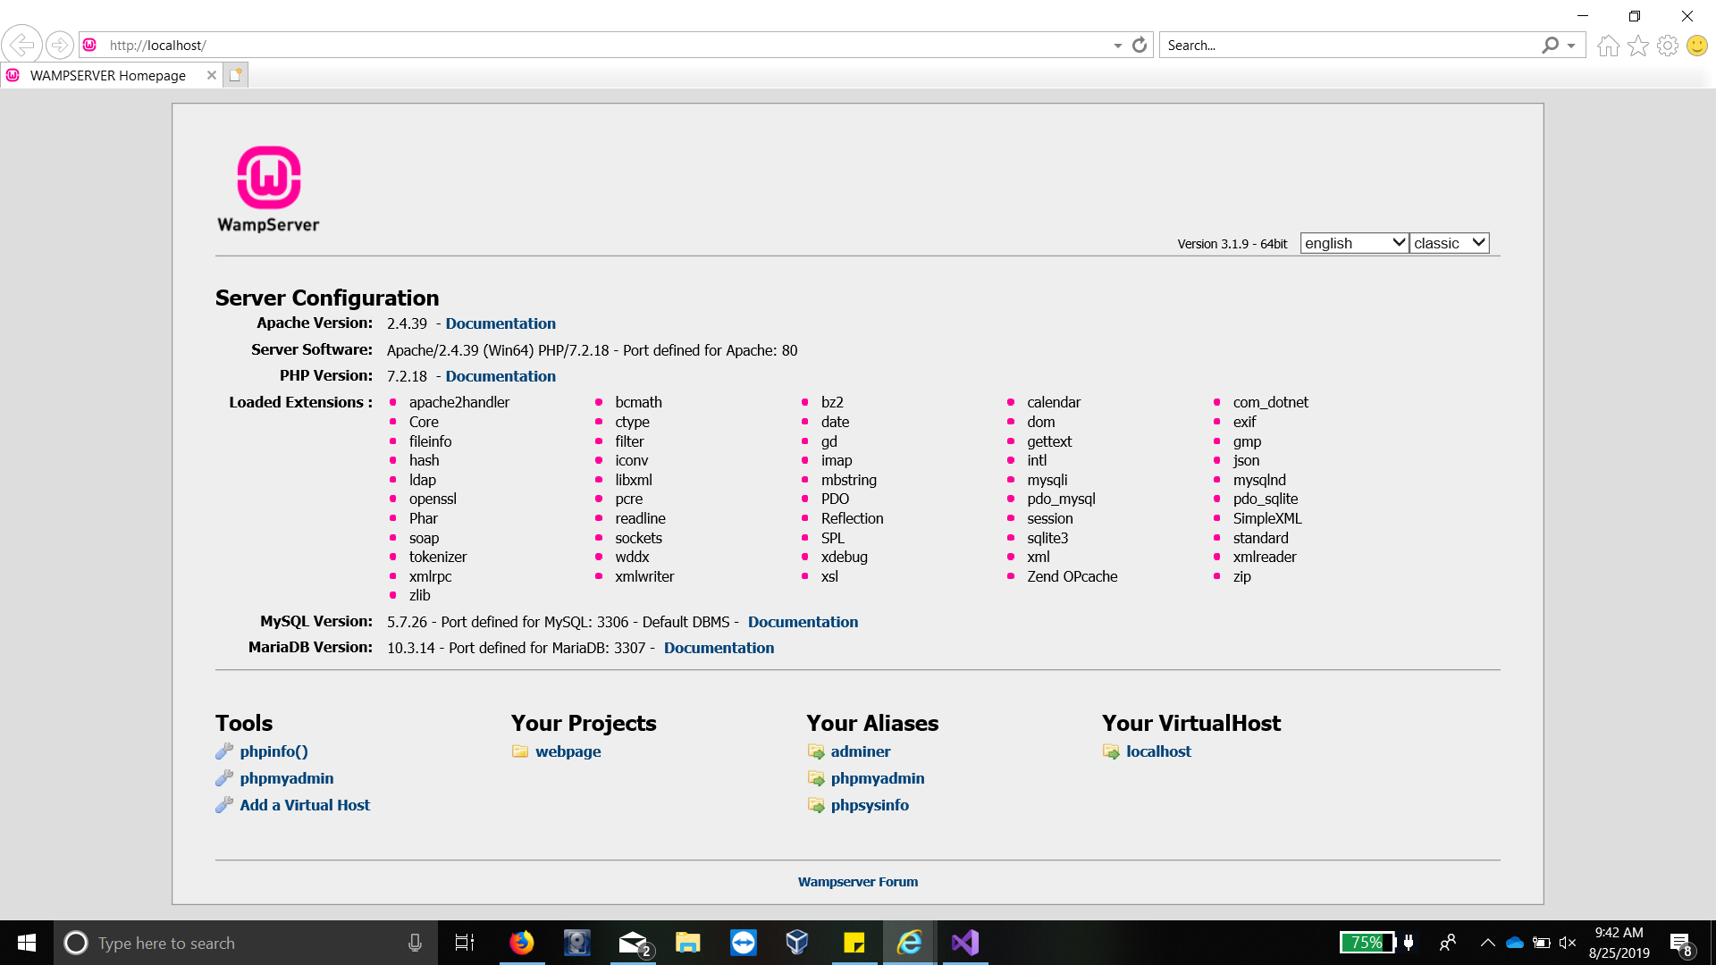

Slide 16
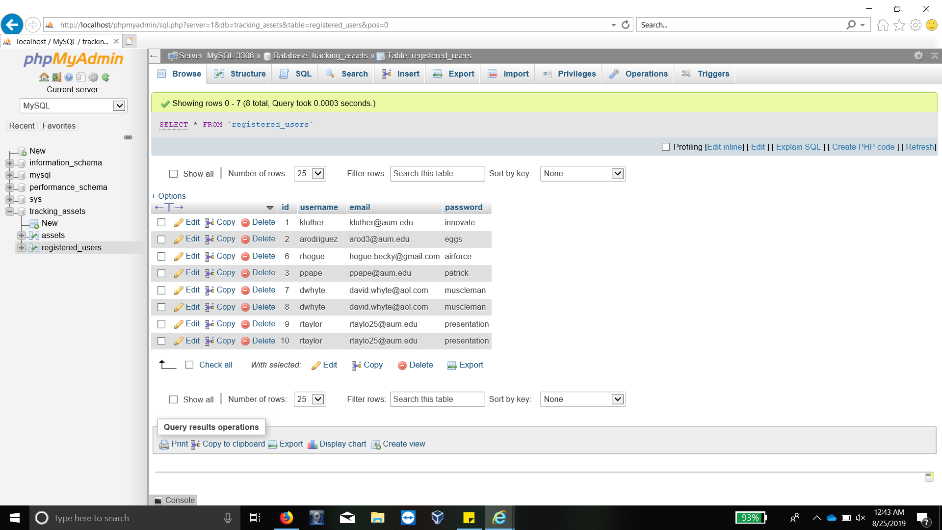

Slide 17
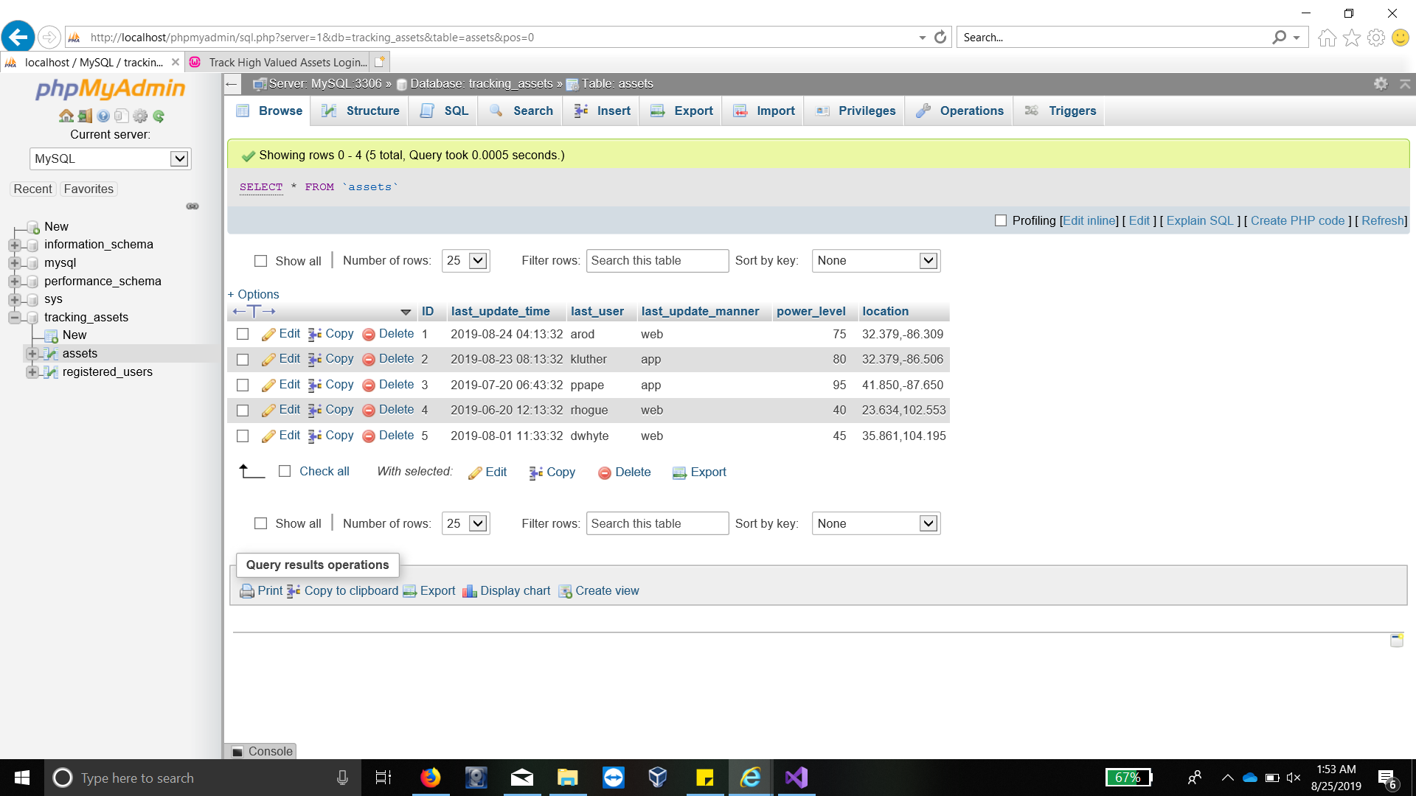

Slide 18
Prototype Presentation Video
https://www.youtube.com/watch?v=fLSbC_v1v2U&feature=youtu.be
Continue for embedded video

Slide 19
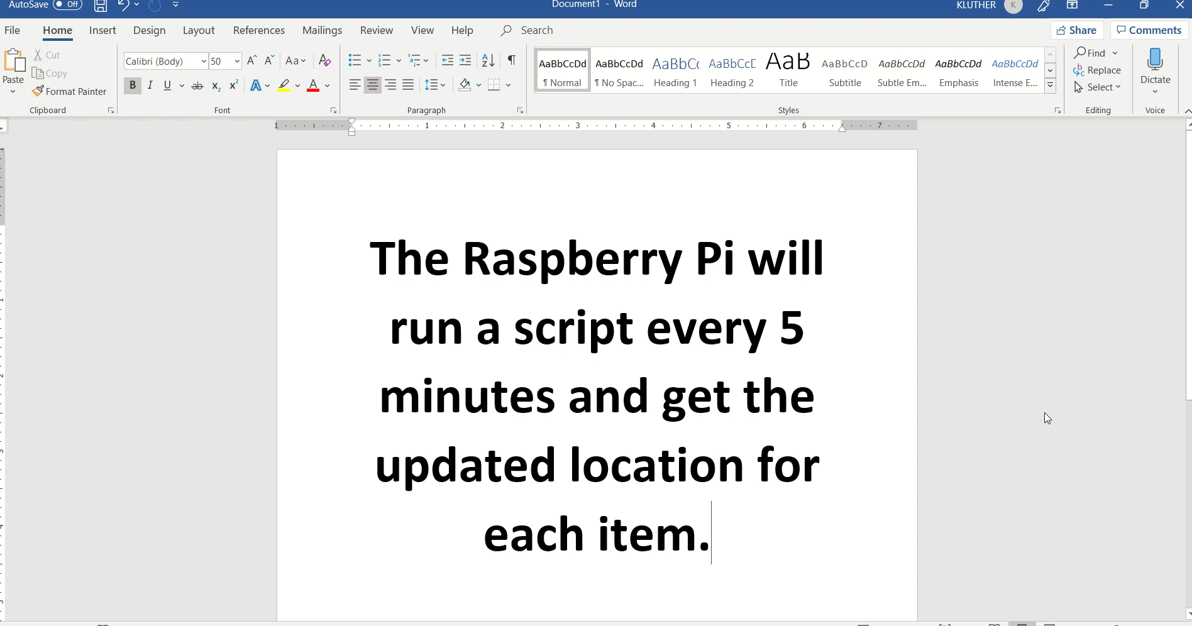

Slide 20
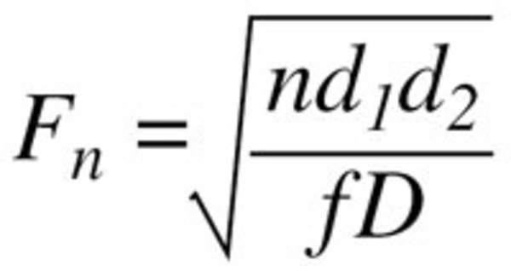
Calculations
Raspi Battery life:
Raspberry pi 3.1A to operate
Requires at least 74.5Ah Battery to meet 24hr battery operation life
(a larger battery will be required if pi is constantly updating server and receiving data and using NFC antenna)
Triangulation of Wifi Routers[2]:
Fade Margin equation
Free Space Path Loss (dB) = 20log10(d) + 20log10(f) + K
Distance (km) = 10(FSPL – 32.44 – 20log10(f))/20

Slide 21
Continuation Ideas
Rather than having a central database of items/assets, it would be better to have a local database on each E.G.G. in the even that an E.G.G. where to start emitting erroneous data (NFC possibility due to noise) Block Chain of EGGs in the event that the central database crashes. Don’t put all your EGGs in one basket
Adding Gyroscope and Accelerometers to increase accuracy of relative locations.

Slide 22
Works Cited
[1]: Pixie Lost & Found Survey conducted in October 2016 using the world's largest panel provider, Survey Sampling International. The survey analyzed findings of a representative sample of over 1,700 people https://www.prnewswire.com/news-releases/lost-and-found-the-average-american-spends-25-days-each-year-looking-for-lost-items-collectively-costing-us-households-27-billion-annually-in-replacement-costs-300449305.html
[2]https://stackoverflow.com/questions/11217674/how-to-calculate-distance-from-wifi-router-using-signal-strength

